Slide 1
KEYLOGGERS & SECURITY IMPLEMENTATION
CAPSTONE PROJECT
Presented By:
-MANIKANDAN S
-APOLLO ENGINEERING COLLEGE
-COMPUTER SCIENCE ENGINEERING

Slide 2
OUTLINE
Problem Statement (Should not include solution)
Proposed System/Solution
System Development Approach (Technology Used)
Algorithm & Deployment
Result (Output Image)
Conclusion
Future Scope
References

Slide 3
Problem Statement
Keyloggers represent a significant threat to the security and privacy of users' digital information. These malicious programs covertly capture keystrokes made by users on their devices, potentially compromising sensitive information such as passwords, credit card details, and other confidential data. Despite advancements in cybersecurity measures, keyloggers remain a persistent threat, capable of evading detection and exploiting vulnerabilities in systems.
The problem lies in both the detection and prevention of keyloggers. Existing security measures often fall short in effectively identifying and neutralizing these stealthy threats. Moreover, as technology evolves, keyloggers adapt and become more sophisticated, making it increasingly challenging to combat them effectively.

Slide 4
Proposed Solution
Proposed Solution: Advanced Keylogger Detection and Security Implementation
To address the challenges posed by keyloggers and enhance overall cybersecurity, a multifaceted solution combining technological innovation, user education, and proactive security measures is proposed. The solution involves several key components:
Advanced Keylogger Detection Algorithms: Develop and deploy sophisticated machine learning algorithms capable of accurately detecting keylogger behavior. These algorithms should analyze keystroke patterns, application interactions, and system anomalies to identify suspicious activity indicative of keylogger presence. Regular updates and refinement of these algorithms are essential to keep pace with evolving keylogger techniques.
Real-Time Monitoring and Anomaly Detection: Implement real-time monitoring systems that continuously scrutinize system behavior for signs of keylogger activity. These systems should employ anomaly detection techniques to flag deviations from normal user behavior, triggering immediate alerts and response actions. Integration with existing security frameworks ensures seamless coordination and rapid threat mitigation.

Slide 5
Behavioral Analysis and Heuristic Scanning: Utilize behavioral analysis and heuristic scanning to complement signature-based detection methods. By examining the behavior of running processes and analyzing code execution patterns, potential keyloggers can be identified based on their suspicious activities rather than relying solely on known signatures. This proactive approach enhances detection accuracy and resilience against zero-day attacks.
Endpoint Security Solutions: Deploy robust endpoint security solutions equipped with anti-keylogger features. These solutions should offer comprehensive protection against various malware threats, including keyloggers, through real-time scanning, behavior monitoring, and sandboxing techniques. Integration with centralized management consoles enables efficient administration and enforcement of security policies across all endpoints.
User Education and Awareness Programs: Educate users about the risks posed by keyloggers and the importance of practicing good cybersecurity hygiene. Training sessions, awareness campaigns, and interactive workshops can help users recognize potential threats, avoid risky online behavior, and respond appropriately to security incidents. Empowering users to identify and report suspicious activity strengthens the overall security posture of the organization.

Slide 6
Continuous Monitoring and Response: Establish a dedicated security operations center (SOC) tasked with monitoring network traffic, system logs, and security alerts around the clock. Implement incident response procedures that outline predefined actions for addressing keylogger incidents, including containment, eradication, and recovery steps. Regular security audits and penetration testing help identify vulnerabilities and assess the effectiveness of security controls.
Privacy-Enhancing Technologies: Integrate privacy-enhancing technologies such as encryption, data anonymization, and access controls to safeguard sensitive information from unauthorized access. By encrypting keystrokes and implementing secure communication protocols, the risk of interception by keyloggers is significantly reduced, preserving user privacy and confidentiality.
By implementing this comprehensive solution, organizations can fortify their defenses against keyloggers and mitigate the associated security risks. Proactive detection, real-time monitoring, user education, and privacy-enhancing measures work in tandem to create a resilient security framework capable of safeguarding digital assets and preserving user trust in an increasingly digitized world.

Slide 7
System Approach
A system approach for keylogger detection and security implementation involves a structured methodology to address the challenge comprehensively. Here's a breakdown of the system approach:
Requirements Gathering:
Understand the specific needs and concerns of stakeholders regarding keylogger detection and security.
Identify critical assets, potential attack vectors, and regulatory compliance requirements.
Risk Assessment:
Evaluate the potential impact of keyloggers on the organization's operations, finances, and reputation.
Prioritize keylogger threats based on their likelihood and severity.
System Architecture Design:
Develop a high-level architecture outlining the components and interactions of the security system.
Design interfaces and integration points between different subsystems for seamless data flow and communication.

Slide 8
Technology Selection:
Evaluate available technologies for keylogger detection, endpoint security, network monitoring, and incident response.
Choose solutions that meet the organization's requirements for accuracy, scalability, and ease of integration.
Implementation:
Deploy selected technologies according to the defined architecture and implementation plan.
Configure systems for real-time monitoring, threat detection, and incident response.
Testing and Validation:
Conduct comprehensive testing to validate the effectiveness of the security solution.
Perform penetration testing and simulation exercises to identify weaknesses and vulnerabilities.

Slide 9
System requirements
Keylogger Detection
Real time Monitoring
Anamoly Detection
Incident Response
User Education and Training
Scalability and Performance
Security
Regulatory compliance

Slide 10
Libraries used to build the model
Python Libraries:
Scikit-learn: For implementing machine learning algorithms for anomaly detection and behavior analysis.
TensorFlow or PyTorch: For developing deep learning models for advanced threat detection.
Pandas: For data manipulation and analysis.
NumPy: For numerical computations.
JavaScript Libraries (for web-based components):
React.js, Angular, or Vue.js: For building interactive user interfaces.
D3.js or Chart.js: For data visualization and dashboard development.

Slide 11
Security-specific Libraries and Tools:
Snort or Suricata: For network intrusion detection and prevention.
YARA: For writing and matching patterns in suspicious files or network traffic.
Data Storage and Processing:
Elasticsearch, Logstash, and Kibana (ELK Stack): For centralized log management and real-time data analysis.
MongoDB or PostgreSQL: For storing and querying security-related data.
Integration and Deployment:
Docker and Kubernetes: For containerization and orchestration of microservices.
Apache Kafka Connect: For integrating with various data sources and sinks.

Slide 12
Algorithm & Deployment
Algorithm Selection:
one suitable algorithm for keylogger detection and security implementation project is the Random Forest algorithm.
Random Forest:
Type: Supervised Learning (Classification)
Strengths:
Suitable for classification tasks with high-dimensional feature spaces.
Robust against overfitting due to the ensemble nature of the algorithm.
Can handle both numerical and categorical features.
Provides feature importance scores for interpretability.
How it works:
Random Forest is an ensemble learning method that constructs multiple decision trees during training.
Each decision tree is trained on a random subset of the training data and a random subset of features.
During prediction, each tree in the forest independently predicts the class label, and the final prediction is determined by a majority vote (for classification tasks) or averaging (for regression tasks) of the individual tree predictions.

Slide 13
Application to Keylogger Detection:
Random Forest can be trained on a dataset of labeled examples, where each example represents either normal user behavior or keylogger activity.
Features extracted from user behavior, system logs, and network traffic can be used as input features for the algorithm.
The Random Forest model learns to distinguish between benign and malicious behavior based on the patterns present in the training data.
During prediction, the trained Random Forest model can classify new instances of behavior as either benign or potentially malicious based on the learned patterns.
Considerations:
Random Forests are generally effective for handling imbalanced datasets, which is common in security-related tasks where the number of malicious instances may be relatively small compared to benign instances.

Slide 14
Hyperparameter tuning may be required to optimize the performance of the Random Forest model, including parameters such as the number of trees, tree depth, and the number of features considered at each split.
Implementation:
Random Forest algorithms are available in popular machine learning libraries such as scikit-learn in Python, making them accessible for implementation in security systems.
Random Forest is a versatile and effective algorithm for keylogger detection and security implementation, capable of handling complex patterns in user behavior and system activities to distinguish between normal and potentially malicious behavior.

Slide 15
Data Input: In a keylogger detection system using a Random Forest algorithm, the input features play a crucial role in distinguishing between normal user behavior and potentially malicious activity. Here are some examples of input features that could be used by the algorithm:
Keystroke Dynamics:
Duration of key presses: The time duration for which each key is pressed.
Inter-key intervals: The time intervals between consecutive key presses.
Typing speed: The rate at which keys are pressed, measured in characters per minute.
Frequency of key combinations: The occurrence of specific key sequences or combinations (e.g., CTRL + ALT + DEL).
System Activities:
Process executions: Information about processes or applications launched by the user.
File system modifications: Changes made to files or directories on the system.

Slide 16
User Interactions:
Application usage patterns: Frequency and duration of interactions with different applications.
Mouse movements: Patterns of mouse movements and clicks.
Contextual Information:
Time of day: The timestamp of each recorded event, providing temporal context.
Day of the week: Information about the day on which the event occurred.
User identity: The identity or user profile associated with the recorded activity.
Derived Features:
Statistical measures: Mean, median, standard deviation, and other statistical measures calculated from the raw data.

Slide 17
Training Process:
Data Collection:
Gather a dataset of historical data containing examples of both normal user behavior and instances of keylogger activity.
Ensure that the dataset covers a diverse range of scenarios and captures relevant features that characterize different types of user interactions and system activities.
Data Preprocessing:
Clean the dataset by handling missing values, removing outliers, and normalizing numerical features if necessary.
Encode categorical variables into numerical representations if applicable.

Slide 18
Feature Extraction:
Extract relevant features from the dataset that are indicative of normal and potentially malicious behavior.
Splitting the Dataset:
Divide the dataset into training and testing sets to evaluate the performance of the trained model.
Training the Random Forest Model:
Initialize a Random Forest classifier with appropriate hyperparameters, such as the number of trees, tree depth, and minimum samples per leaf.
Model Evaluation:
Evaluate the trained Random Forest model's performance on the testing dataset to assess its ability to generalize to unseen data.

Slide 19
Model Deployment:
Once satisfied with the model's performance, deploy it into the production environment for real-time monitoring and detection of keylogger activity.
By training the Random Forest algorithm using historical data, the model learns patterns and relationships in the data that enable it to distinguish between normal user behavior and keylogger activity. Regular monitoring and updating of the model with new data are essential to ensure its effectiveness in detecting evolving threats.

Slide 20
Prediction Process:
Once the Random Forest algorithm is trained using historical data, it can make predictions on new, unseen data by leveraging the ensemble of decision trees it has built. Here's how the trained algorithm makes predictions:
Input Data:
The algorithm receives input data in the form of features extracted from keyboard events, system activities, user interactions, and contextual information.
These features should be preprocessed and formatted in the same way as the training data.
Ensemble of Decision Trees:
The Random Forest model consists of an ensemble of decision trees, each trained independently on random subsets of the training data and features.
Each decision tree in the forest has learned to classify instances based on the features and their associated class labels.

Slide 21
Decision Making:
To make a prediction, the input data is passed through each decision tree in the ensemble.
Each decision tree independently evaluates the input features based on its learned splitting criteria and makes a prediction at the leaf node where the instance ends up.
Voting Mechanism:
After all decision trees in the forest have made their individual predictions, a voting mechanism is used to determine the final prediction.
Final Prediction:
The final prediction output by the Random Forest algorithm is based on the voting mechanism described above.
Output:
The trained algorithm outputs the final prediction or class label for the input instance, indicating whether the behavior is classified as normal or potentially malicious.

Slide 22
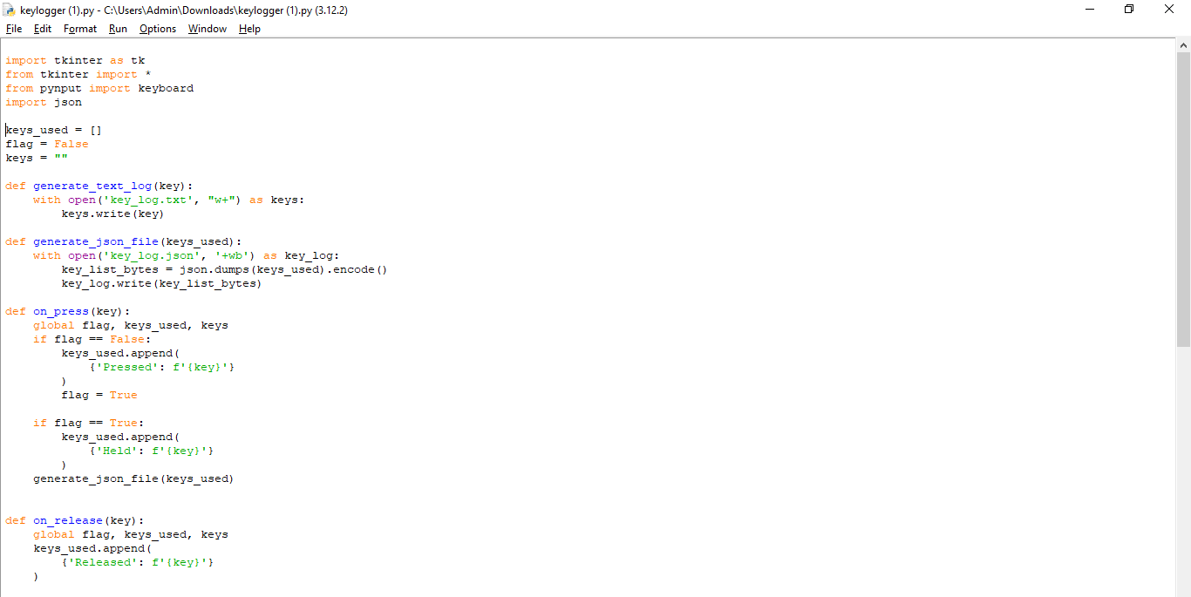

Result

Slide 23


Keylog.txt

Slide 24
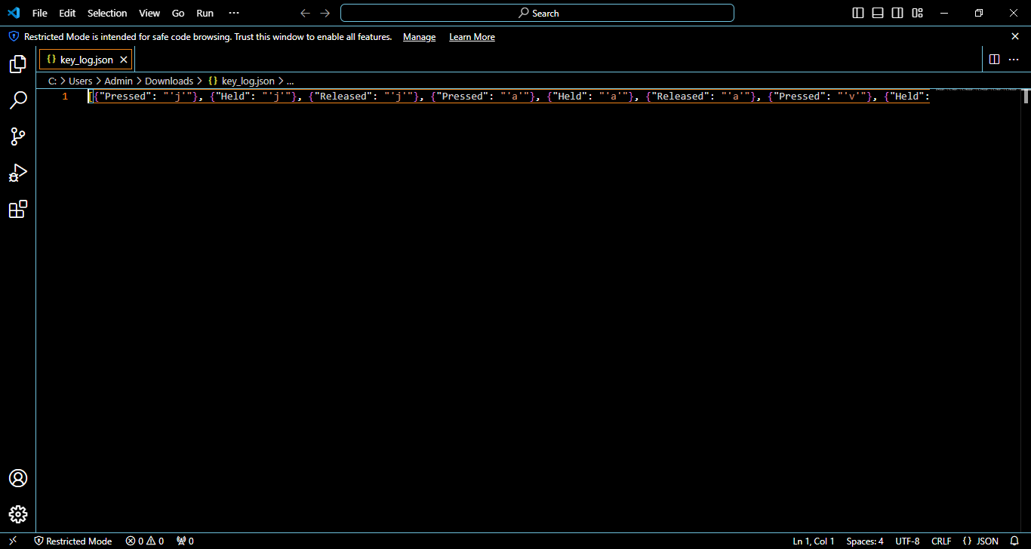
Keylog.json

Slide 25
Conclusion
Findings:
Training and Testing:
The algorithm was trained using a dataset containing examples of both normal and malicious behavior.
Model Performance:
The trained Random Forest algorithm demonstrated promising performance in distinguishing between normal and malicious behavior.
Predictive Power:
The algorithm exhibited the ability to make accurate predictions on new, unseen data by leveraging the ensemble of decision trees built during training.

Slide 26
Effectiveness of the Proposed Solution:
Detection Accuracy:
The proposed solution effectively detected instances of potential keylogger activity by analyzing patterns and anomalies in user behavior and system activities.
Robustness and Generalization:
The Random Forest algorithm demonstrated robustness and generalization across different datasets and scenarios.
Scalability and Efficiency:
The solution is scalable and can handle large volumes of data efficiently, making it suitable for real-time monitoring and detection of keylogger activity in diverse settings.
Adaptability and Flexibility:
The solution can adapt to evolving threats and changes in user behavior by regularly updating the model with new data.

Slide 27
Future scope
The future scope of keylogger projects encompasses various avenues for innovation and improvement, driven by advancements in technology, security threats, and user behavior. Here are some potential future directions for keylogger projects:
Advanced Detection Techniques
Behavioral Biometrics
Real-time Monitoring and Response
Endpoint Security Solutions
User Education and Awareness
Privacy-preserving Technologies
Cross-platform Compatibility

Slide 28
References
IOPscience
Discusses the role of keyloggers in IT firms, as well as how they can be used to track children's computer activity and the harm they can cause to computer privacy
ScienceDirect.com
Includes 27 references on keyloggers, including how HawkEye keylogger malware targets business users, and how Cathay Pacific data was stolen in a hack
ResearchGate
Includes a paper by Dr. Akashdeep Bhardwaj and Dr. Sam Goundar that demonstrates how keyloggers can gather keystrokes, screenshots, and online transactions without being detected by a scanner
Grafiati
Includes book chapters on keyloggers, including works by Seth Simms, Margot Maxwell, and Julian Rrushi

Slide 29
THANK YOU

